Slide 1


MPS
IT Implementation on Library
BPH
Kelompok 10
Laura Al Khansa
Namira Assalwa
Muhammad Adib Arkan
Komisi 1
Komisi 2
Komisi 3
Fungsi
Tugas
Proker
Kriteria

Slide 2
IT Implementation on Library
Kelompok 10
Laura Al Khansa
Namira Assalwa
Muhammad Adib Arkan
System Analysis
Hardware
Software
Topology
Map
Cost

Slide 3

MPS
SYSTEM ANALYSIS
BPH
The library provides a variety of information resources, including books and digital access, as well as computer and wifi facilities to support students. With a Local Area Network (LAN), the library integrates devices such as CCTV, PCs, and lending machines, allowing visitors to borrow and return books independently. Cloud data storage for CCTV footage and transaction history improves resource management and security.
Komisi 1
Komisi 2
Komisi 3
Fungsi
Tugas
Proker
Kriteria

Slide 4

SYSTEM ANALYSIS
System Analysis
Hardware
The library provides a variety of information resources, including books and digital access, as well as computer and wifi facilities to support students. With a Local Area Network (LAN), the library integrates devices such as CCTV, PCs, and lending machines, allowing visitors to borrow and return books independently. Cloud data storage for CCTV footage and transaction history improves resource management and security.
Software
Topology
Map
Cost

Slide 5
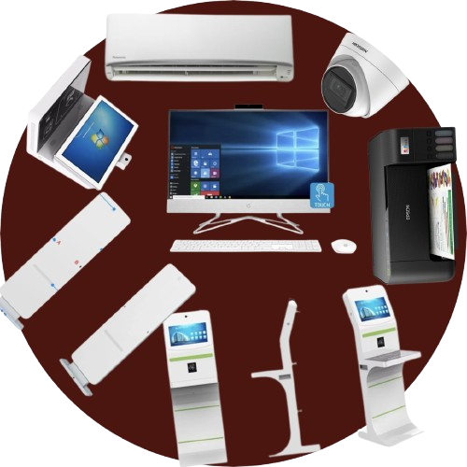
Hardware
Specification
System Analysis
Hardware
Software
Topology
Map
Cost

Slide 6
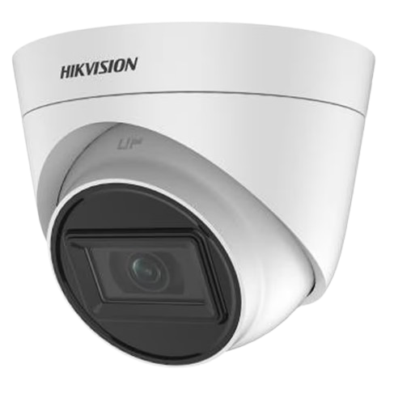
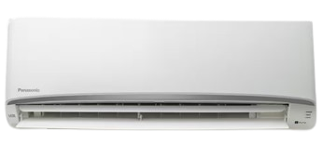
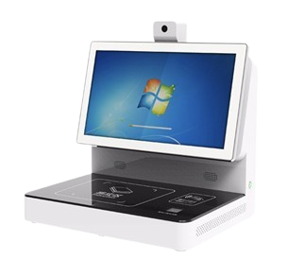
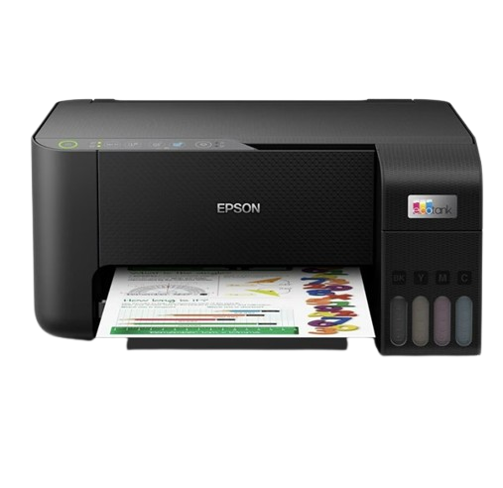
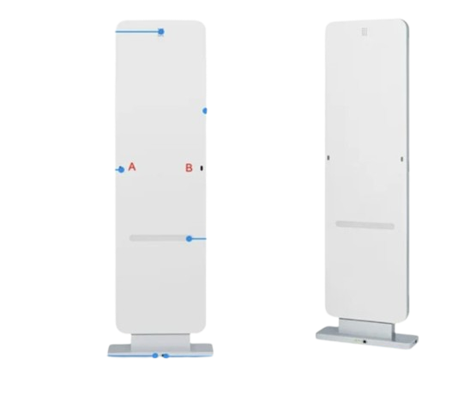
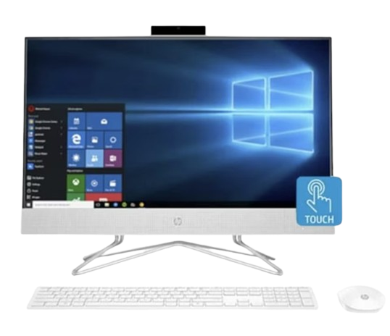
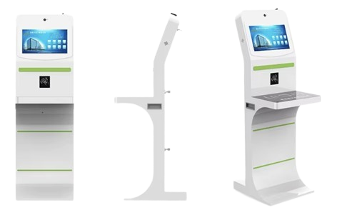
MPS
Hardware
Hikvision Turbo EXIR ECO Series Camera DS-2CE78H0T-IT1F Turbo 5MP, 8MP
Specification
Panasonic AC Single Split Non-inverter CS-PN18TKP 2PK
BPH
Komisi 1
Book Detetor Library Management ISO15693 Library Reader
Komisi 2
Epson Printer Colour Multi Function L Series L3250
Komisi 3
Fungsi
Anti Theft Alarm Range RS232 Range RS232 RS485 RFID Reader
Tugas
Smart library automatic borrow and return books Touch Screen RFID card
Proker
Kriteria
HP PC Computer OS Windows 10 Home + OHS 2019 24-df1042d AiO White RAM 8GB

Slide 7
Hardware
Specification
System Analysis
Hardware
Software
Topology
Map
Cost

Slide 8
Software
Specification
System Analysis
Hardware
Software
Topology
Map
Cost

Slide 9
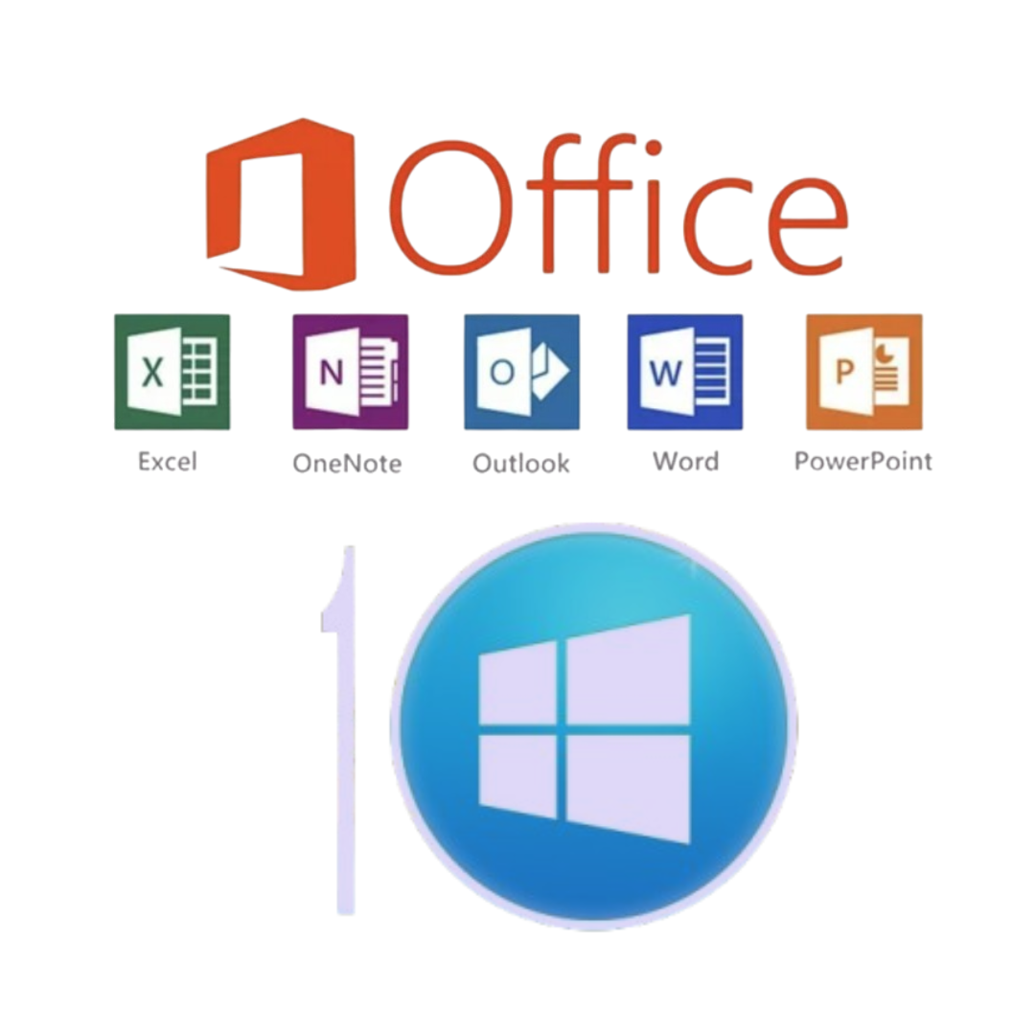
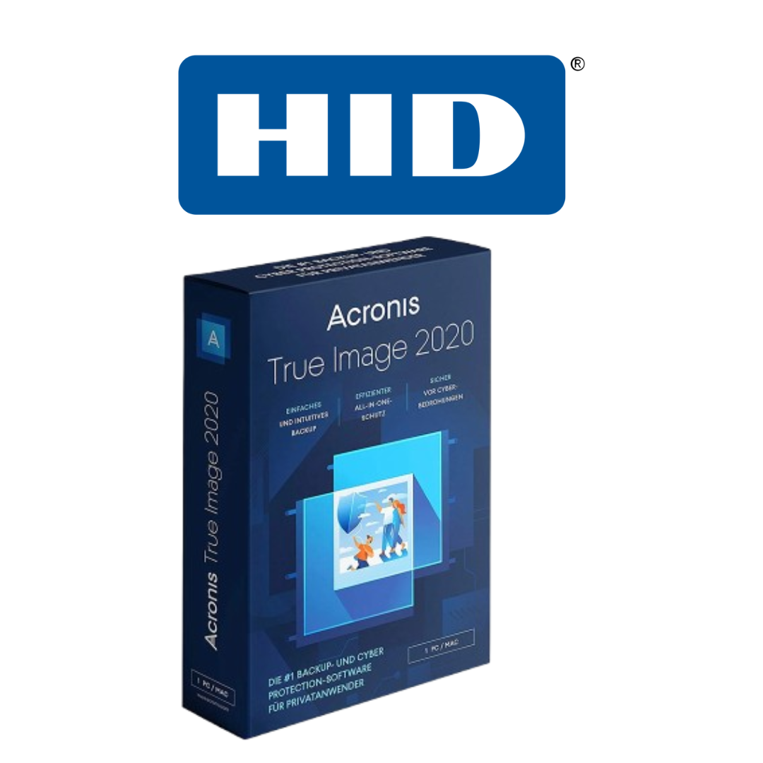

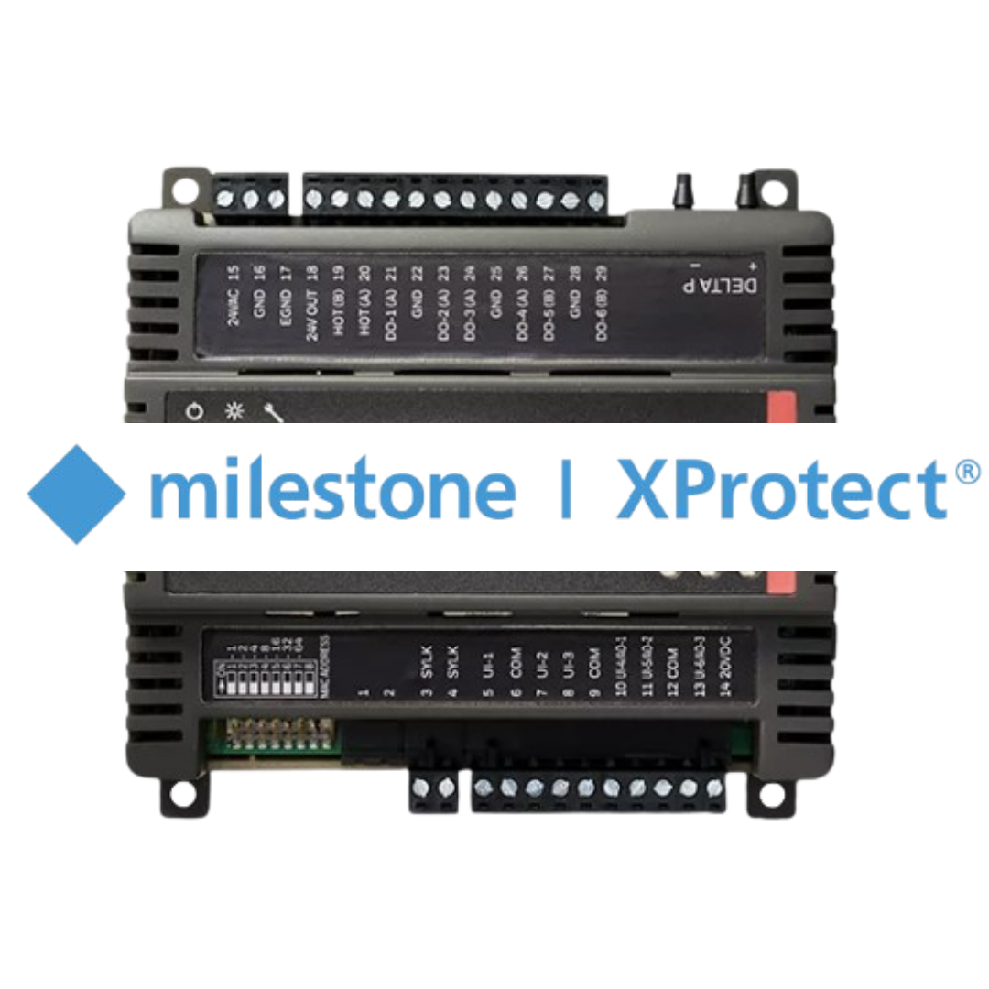

5
4
3
2
1
5
4
3
2
Koha (Library Management System)
Bibliotheca RFID (RFID/BARCODE System)

Slide 10
5
4
3
2
1
5
4
3
Milestone XProtect (Security and Monitoring Software)
Honeywell BMS (Building Management System)

Slide 11
2
1
5
4
3
2
1
5
4
3
PaperCut (Printing Management Software)
Asset Panda (Admin & Inventory Management Software)

Slide 12
2
1
5
4
3
2
1
5
4
3
HID Global (Access Control System)
Acronis Backup (Backup and Data Security Software)

Slide 13
2
1
5
4
3
2
1
5
4
Windows (Operating System)
Microsoft Office (Productivity Software)

Slide 14
Software
Specification
System Analysis
Hardware
Software
Topology
Map
Cost

Slide 15
System Analysis
Hardware
Network Topology Design
Software
Topology
Map
Cost

Slide 16
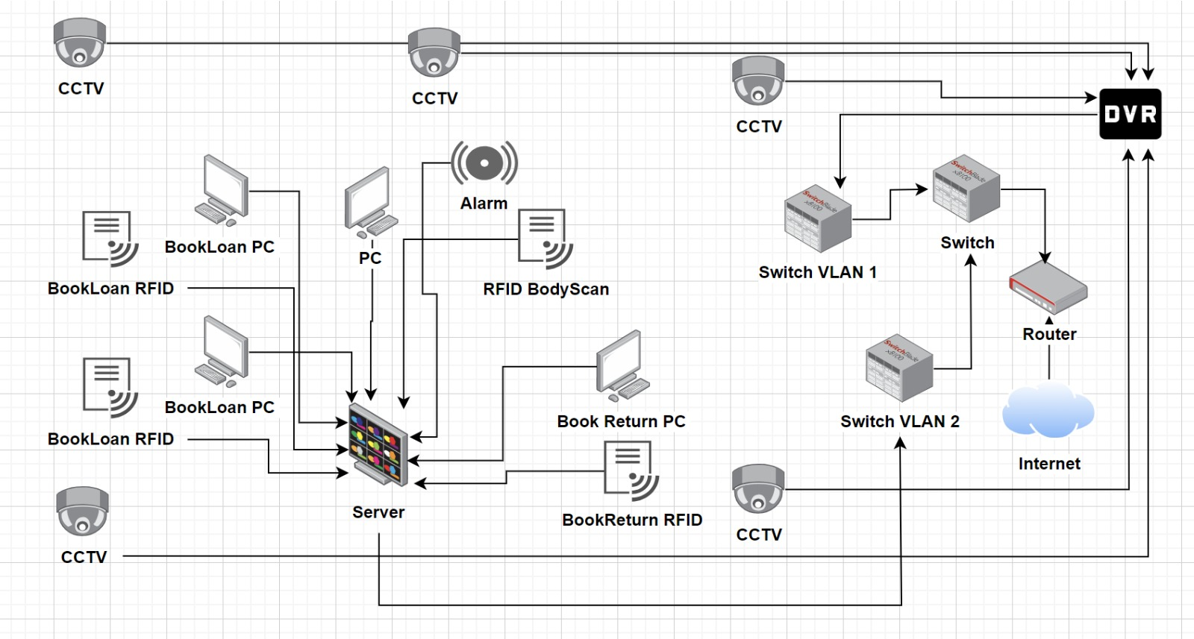

Slide 17
System Analysis
Hardware
Network Topology Design
Software
Topology
Map
Cost

Slide 18
System Analysis
Hardware
Library’s
Floor
Plan
Software
Topology
Map
Cost

Slide 19
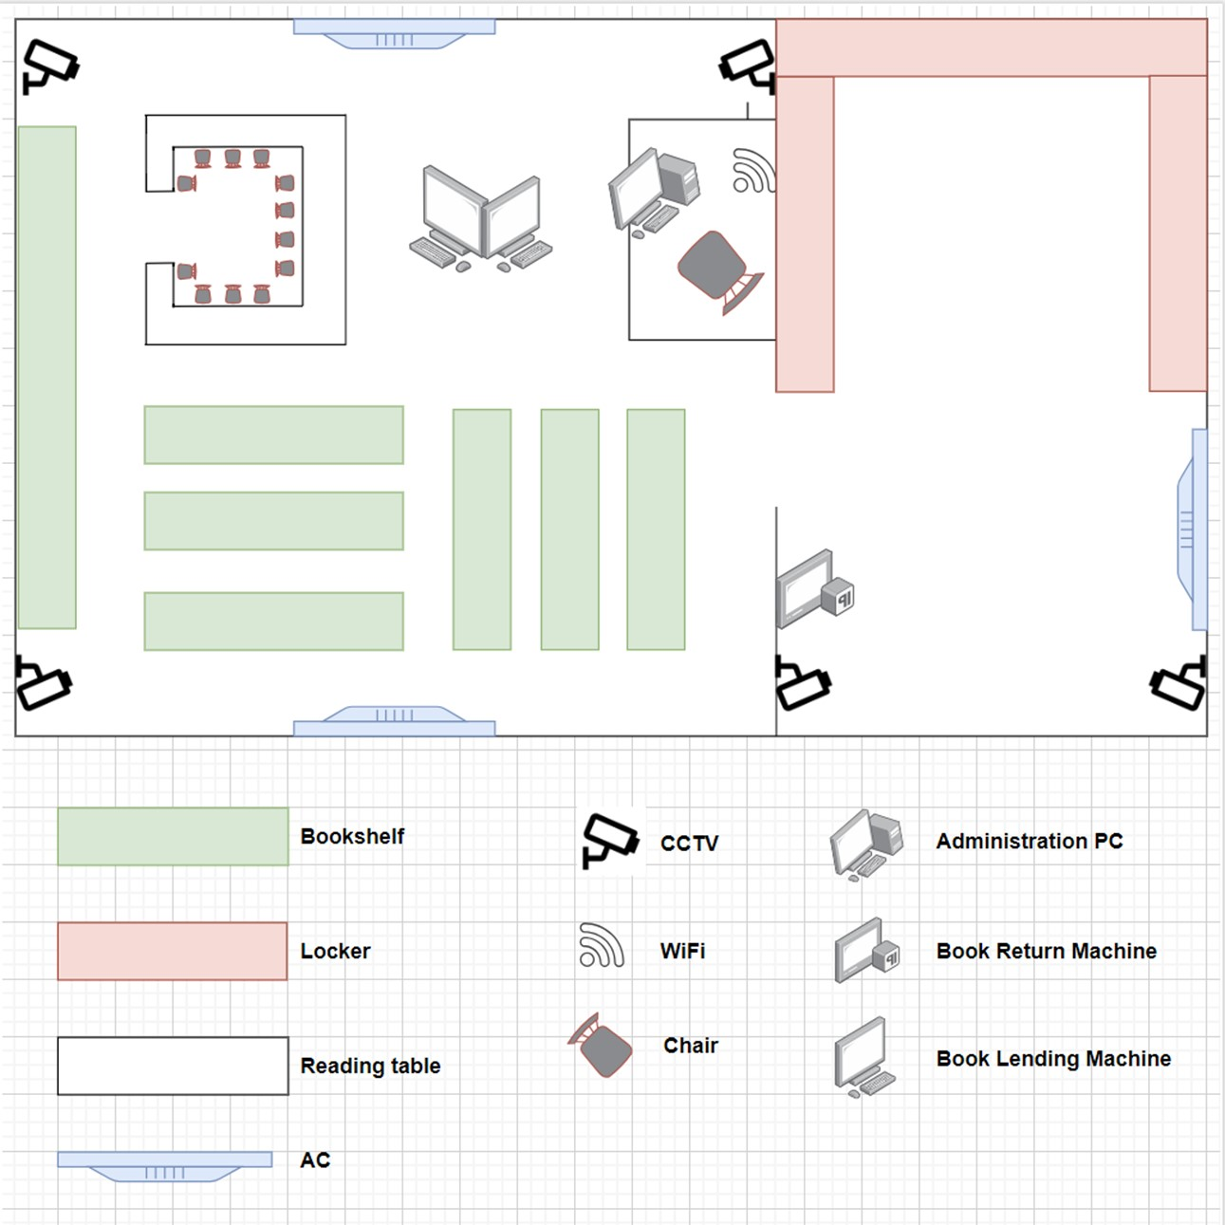

Slide 20
BUDGET
System Analysis
Hardware
Hardware
Software
Provider
Total
Software
Topology
Map
Cost

Slide 21
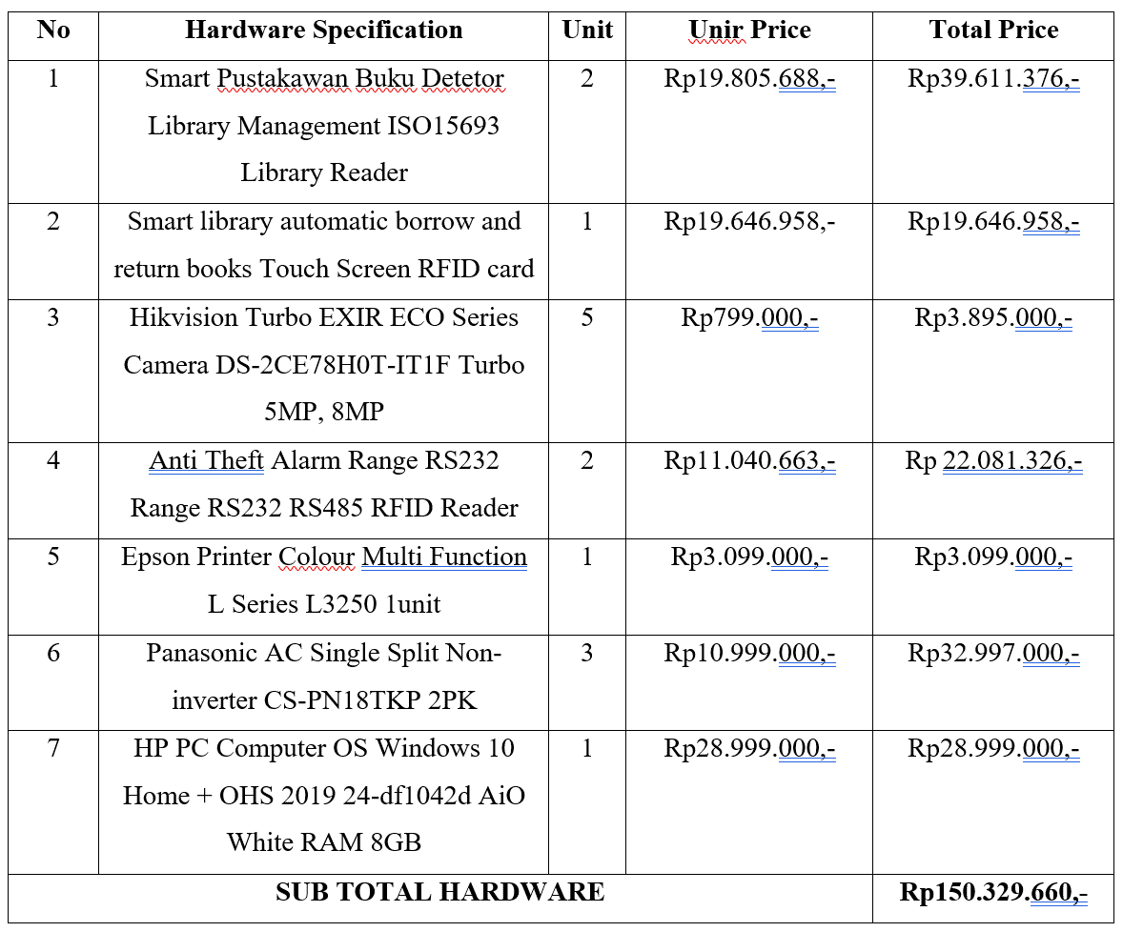
MPS
BUDGET
System Analysis
Hardware
Hardware
Software
Provider
Total
Rp150.329.660,-
Software
Topology
Map
Cost

Slide 22
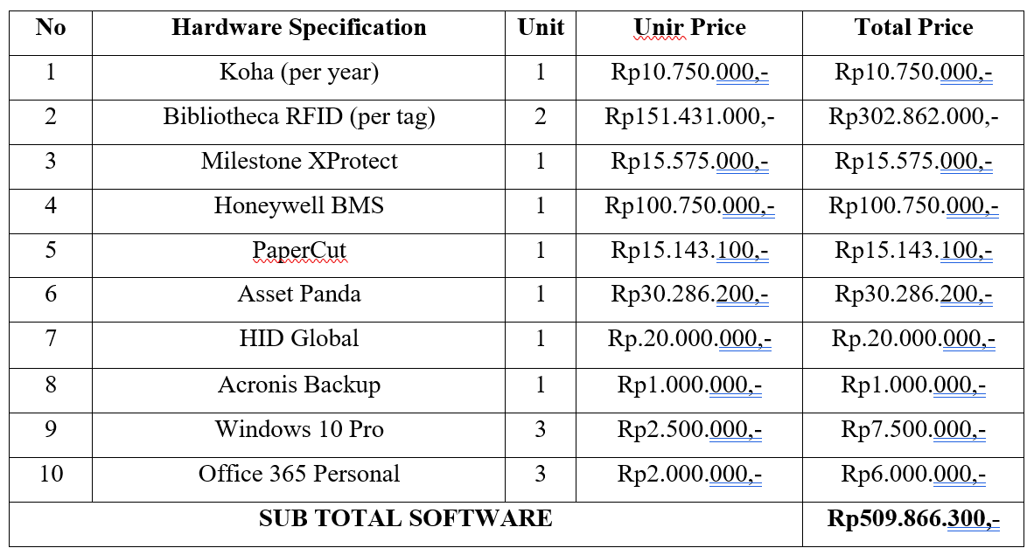
MPS
BUDGET
System Analysis
Hardware
Hardware
Software
Provider
Total
Rp150.329.660,-
Rp509.866.300,-
Software
Topology
Map
Cost

Slide 23
MPS
BUDGET
System Analysis
Hardware
Hardware
Software
Provider
Total
Rp150.329.660,-
Rp509.866.300,-
Rp. 795.000,-
Software
Topology
Map
Cost

Slide 24
MPS
BUDGET
System Analysis
Hardware
Hardware
Software
Provider
Total
Rp150.329.660,-
Rp509.866.300,-
Rp. 795.000,-
Rp660.990.960,-
Software
Topology
Map
Cost

Slide 25

MPS
I gotta go
TERIMA KASIH
BPH
Let’s join us !!!
Komisi 1
Komisi 2
Komisi 3
Fungsi
Tugas
Proker
Kriteria

